Slide 1

CUSTOMER SERVICE DESK
PRESENTED
BY
Y.TEJASVI (06G71A0582)
CH.SOWJANYA(06G71A0567)
K.SUBHASH(06G71A0572)
B.SRINIVAS(06G71A0569)
Under the guidence of
Mr. S.Narsireddy

Slide 2
CONTENTS
Abstract
Existing System
Proposed System
Hardware Requirements
Software Requirements
Modules
Database
Conclusion

Slide 3
ABSTRACT
It is an online comprehensive Customer Care Solution is to manage customer interaction and complaints with the Service Providers over phone or through and e-mail.
The system should have capability to integrate with any Service Provider from any domain or industry like Banking, Telecom, Insurance, etc.
Customer Service also known as Client Service

Slide 4
EXISTING SYSTEM
In the existing system, the information is stored in the form of excel sheets in disk drives.
The information sharing to the Volunteers, Group members, etc. is through mailing feature only.
The information storage and maintenance is more critical in this system and it cannot provide information sharing by 24*7 days.

Slide 5
PROPOSED SYSTEM
The development of this new system is to provide the solution to the problems of existing system.
It is web-enabled so that the information can be shared between the members at any time.
Being a web-enabled system, the process can be accessed across the world over net.

Slide 6
Hardware Requirements
P4 2.8GB processor and above.
Ram 512 MB and above.
HDD 20 GB Hard Disk and above.

Slide 7
Software Requirements
Microsoft .Net framework 2.0.
Microsoft ASP.Net.
Microsoft C#.Net language.
Microsoft SQL Server 2008
HTML

Slide 8
MODULES
Administration
Customers
Service providers
services

Slide 9
ADMIN
Administrator or Manger is treated as a super user in this system.
He can track all customers with voice recording facility.
He can track the customer complaints ticket create, edit facilities by customer or service providers.
Admin facilities to add, view, edit different types of interactions and complaints.

Slide 10
DATABASE TABLES
Login Table:
Sno | ColoumnName | Datatype(size) | Constraints
1 | UserId | Int | PrimaryKey
2 | UserName | Varchar(50) | NotNull
3 | Password | Varchar(50) | NotNull
4 | Emp_cus_Id | Int | ForeignKey
5 | Role | Varchar(50) | NotNull

Slide 11
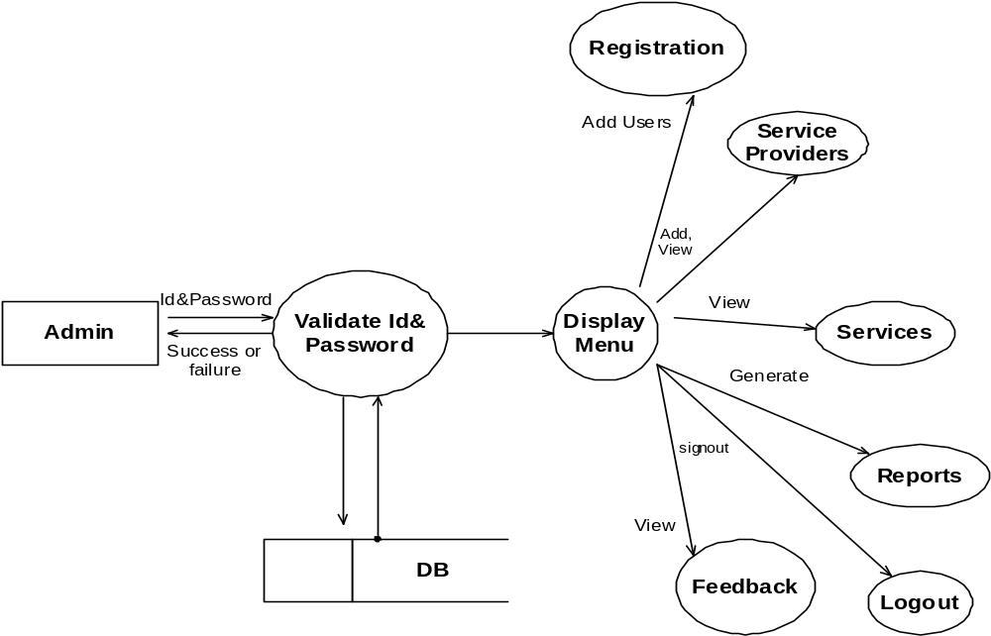
Diagram for Admin

Slide 12
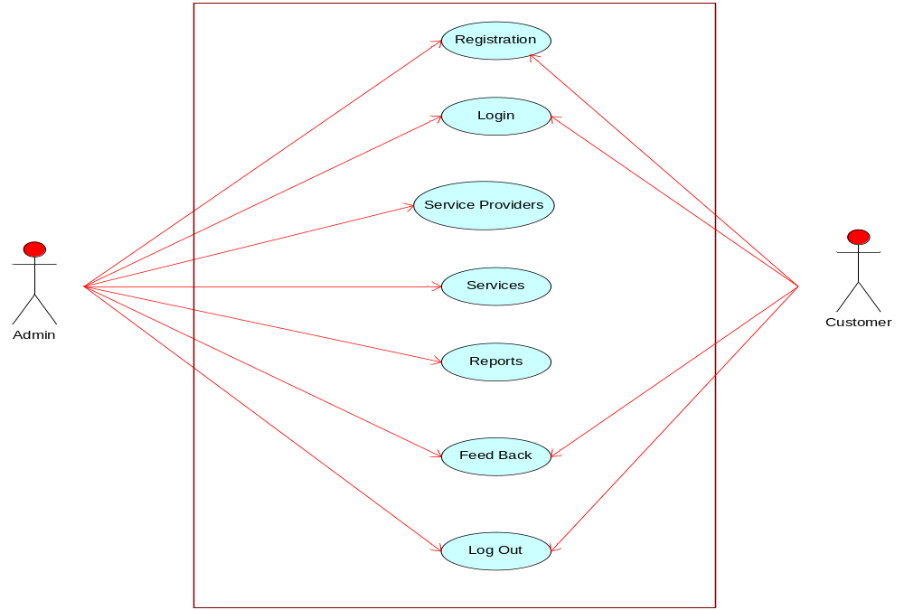
Use Case Diagram:

Slide 13
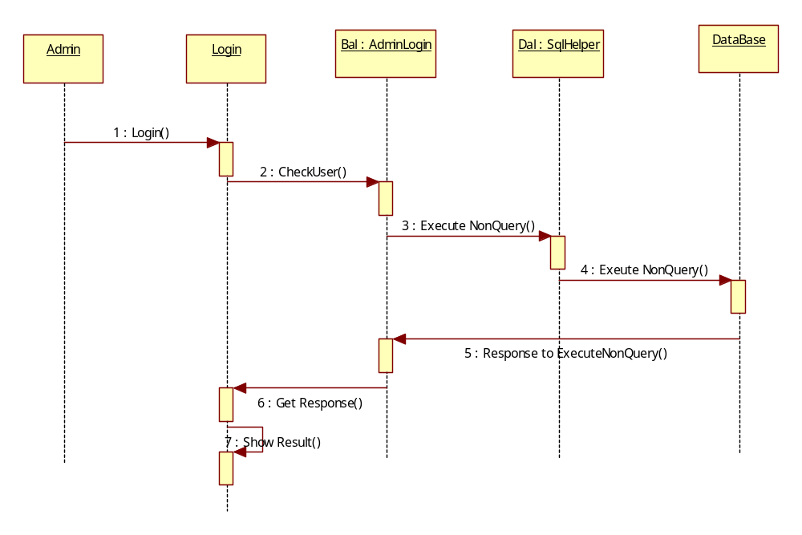
Administrator Login Sequence Diagram

Slide 14
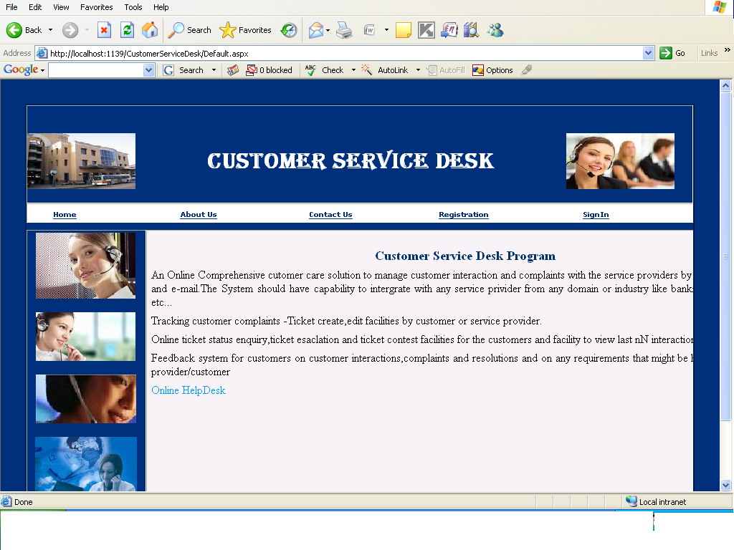
WELCOME FOR PROJECT:

Slide 15
CUSTOMERS
A group of services are provided to customer like banking, telecom, railway etc.
A customer complaint with voice is recorded in this system, and process the complaint within a certain amount of time.

Slide 16
Customer feedback table:
Sno | Coloumnname | Datatype(size) | Constraints
1 | FeedBackId | Int | primarykey
2 | CustomerId | Int | Foreign Key
3 | FeedBackDate | Datetime | NotNull
4 | feedBackText | Varchar(50) | NotNull
5 | Emailid | Varchar(50) | NotNull
6 | FeedBackVoiceFile | Varbinary(max) | NotNull
7 | VoiceFileName | Varchar(50) | NotNull
8 | ComplaintRegistrationId | int | ForeignKey

Slide 17
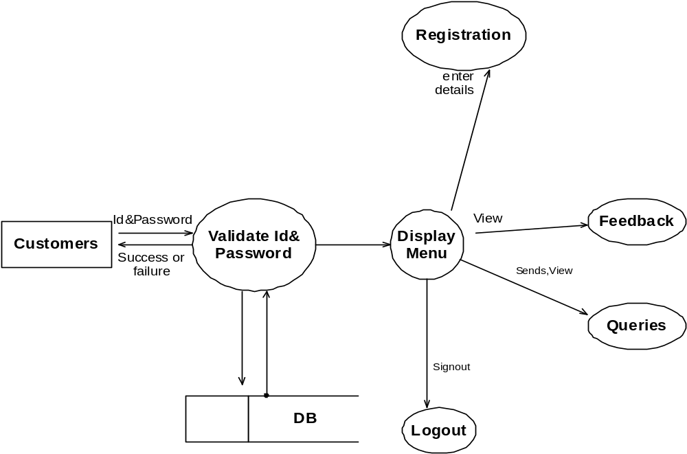
Diagram for Customers:

Slide 18
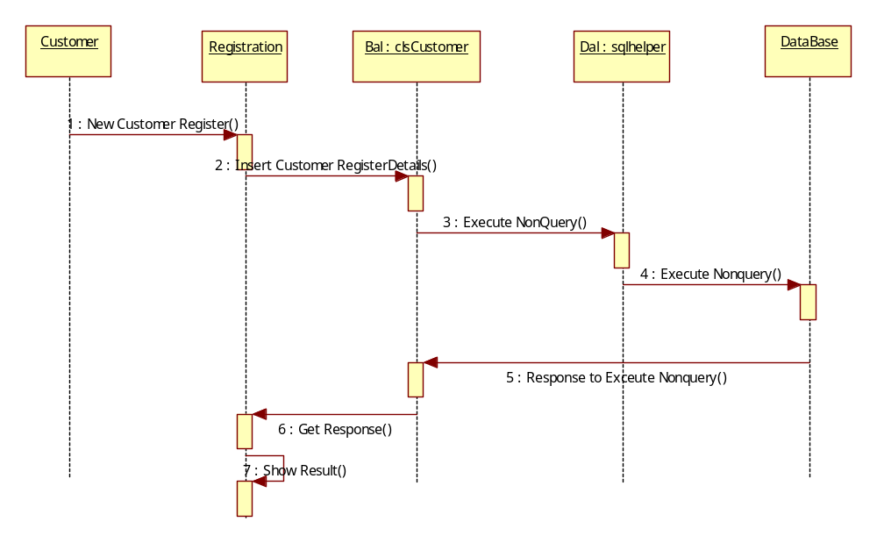
Customer Registration Sequence Diagram

Slide 19
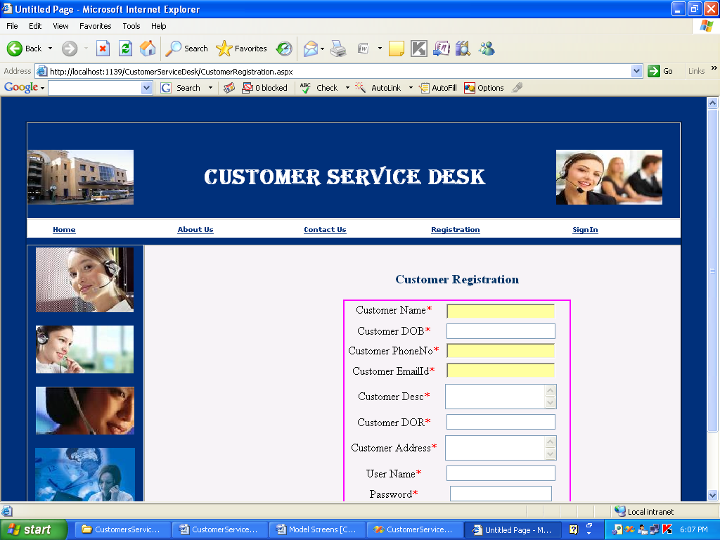
Customer Registration:

Slide 20
SERVICE PROVIDERS
The service providers will provide the services what the customer needed.
Customers will send his details through e-mail or phone to access the services from service providers.
The service providers will provide the services like banking,telecom etc.,

Slide 21
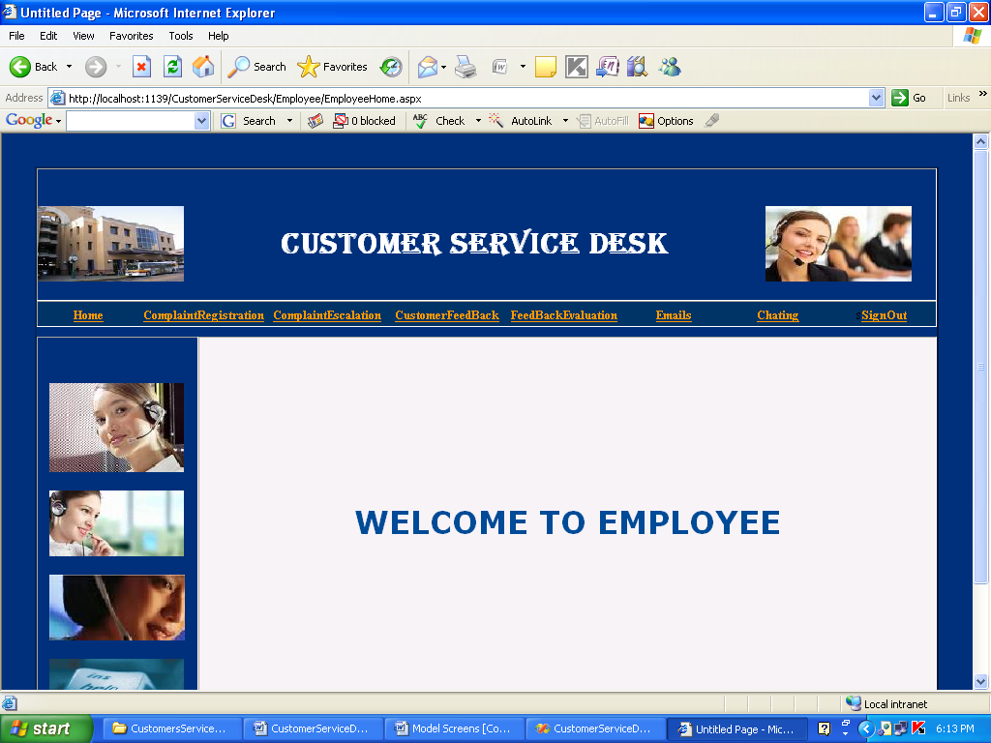
Employee Home page:

Slide 22
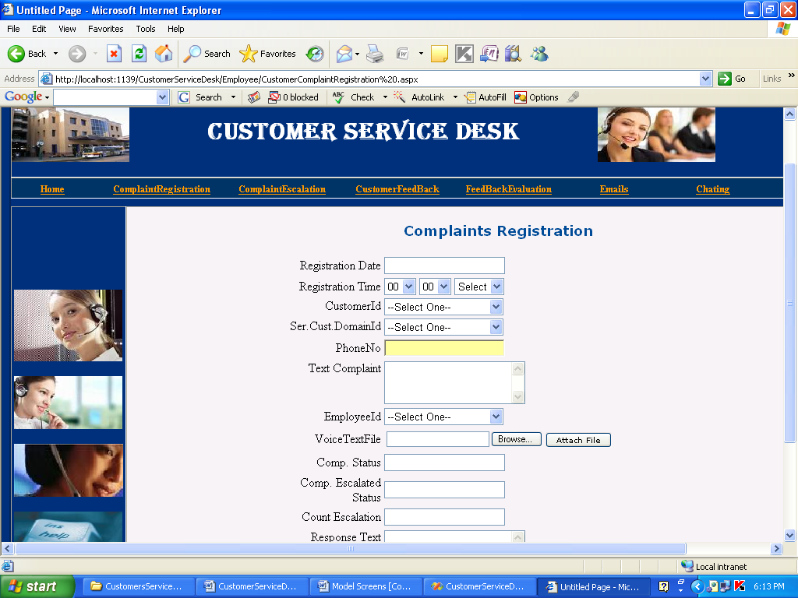
Employee Complaint Regisrtation:

Slide 23
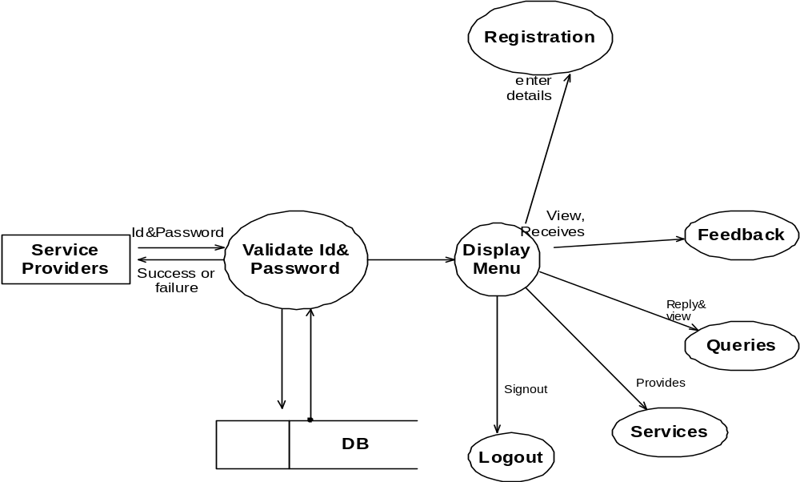
Diagram for service Providers:

Slide 24
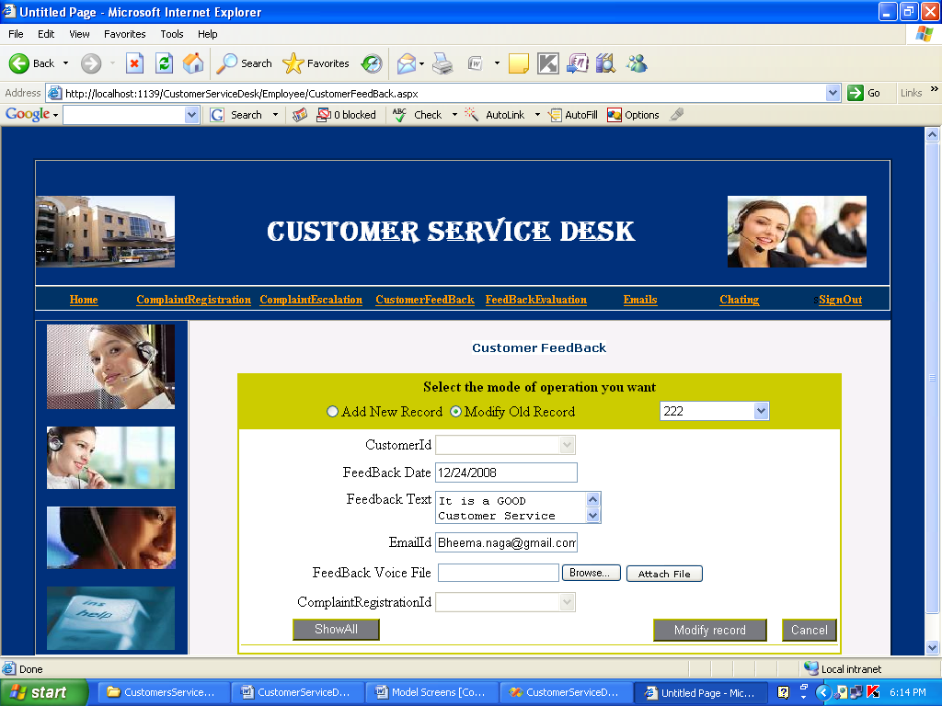
Customer Feedback:

Slide 25
SERVICES
The details provided by the customers are verified by services (either success or failure).
The service details are send to services like banking,telecom,railways etc…
These details are saved in service database and services are provided to the customers.

Slide 26
Service Customers Table
Sno | Column Name | Data Type(Size) | Consraints
1 | ServiceCustomerId | Int | Primarykey
2 | ServiceCustomerName | Varbinary(50) | AllowNull
3 | ServiceCustomerDOR | DateTime | AllowMulls
4 | CustomerAddress | Varchar(50) | AllowNulls
5 | CustomerPhoneNum | Varbinary(50) | AllowNull
6 | CustomerEmail | Varbinary(50) | AllowNull
7 | ServiceCustomerInchargeId | int | NotNull
8 | ServiceCustomerDomainDesc | Varchar(2000) | AllowNull

Slide 27
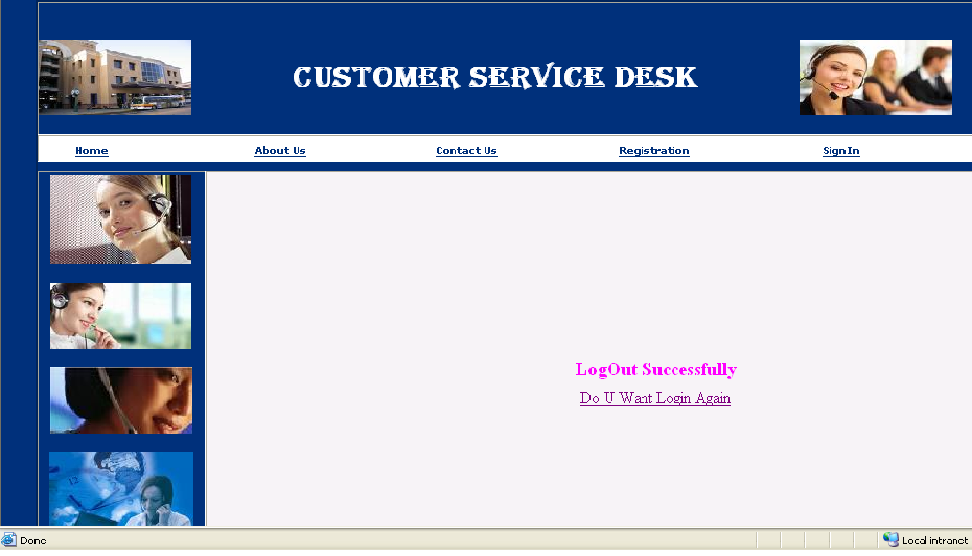
Employee Logout Page:

Slide 28
Conclusion
It is a web-enabled project.
With this project the details about the product will be given to the customers in detail with in a short span of time.
Queries regarding the product or the services will also be clarified.
It provides more knowledge about the various technologies.

Slide 29
THANK YOU

